Slide 1
Lecture 10: Multivariate spatial models

Slide 2
Discussion topics:
Joint species distribution models
Stomach contents
Ordination
Phylogenetic comparative methods
Trait-based approaches
Separable multivariate spatio-temporal models
Additive models and variance decomposition

Slide 3
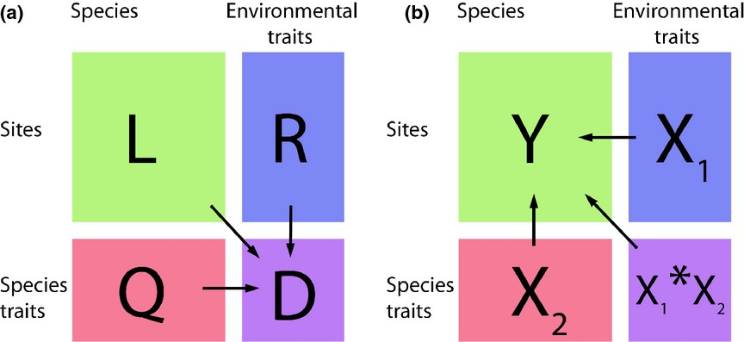
Joint species distribution models
Brown, A. M., D. I. Warton, N. R. Andrew, M. Binns, G. Cassis, and H. Gibb. 2014. The fourth-corner solution – using predictive models to understand how species traits interact with the environment. Methods in Ecology and Evolution 5:344–352.

Slide 4
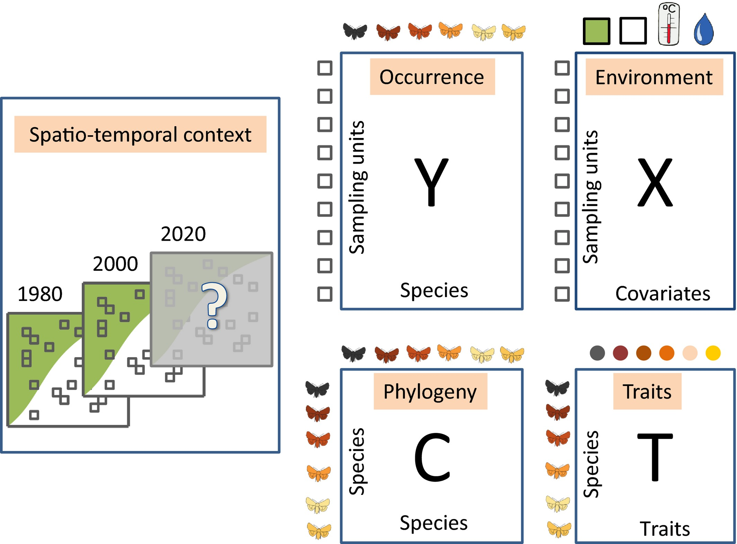
Joint species distribution models
Ovaskainen, O., G. Tikhonov, A. Norberg, F. G. Blanchet, L. Duan, D. Dunson, T. Roslin, and N. Abrego. 2017. How to make more out of community data? A conceptual framework and its implementation as models and software. Ecology Letters 20:561–576.

Slide 5
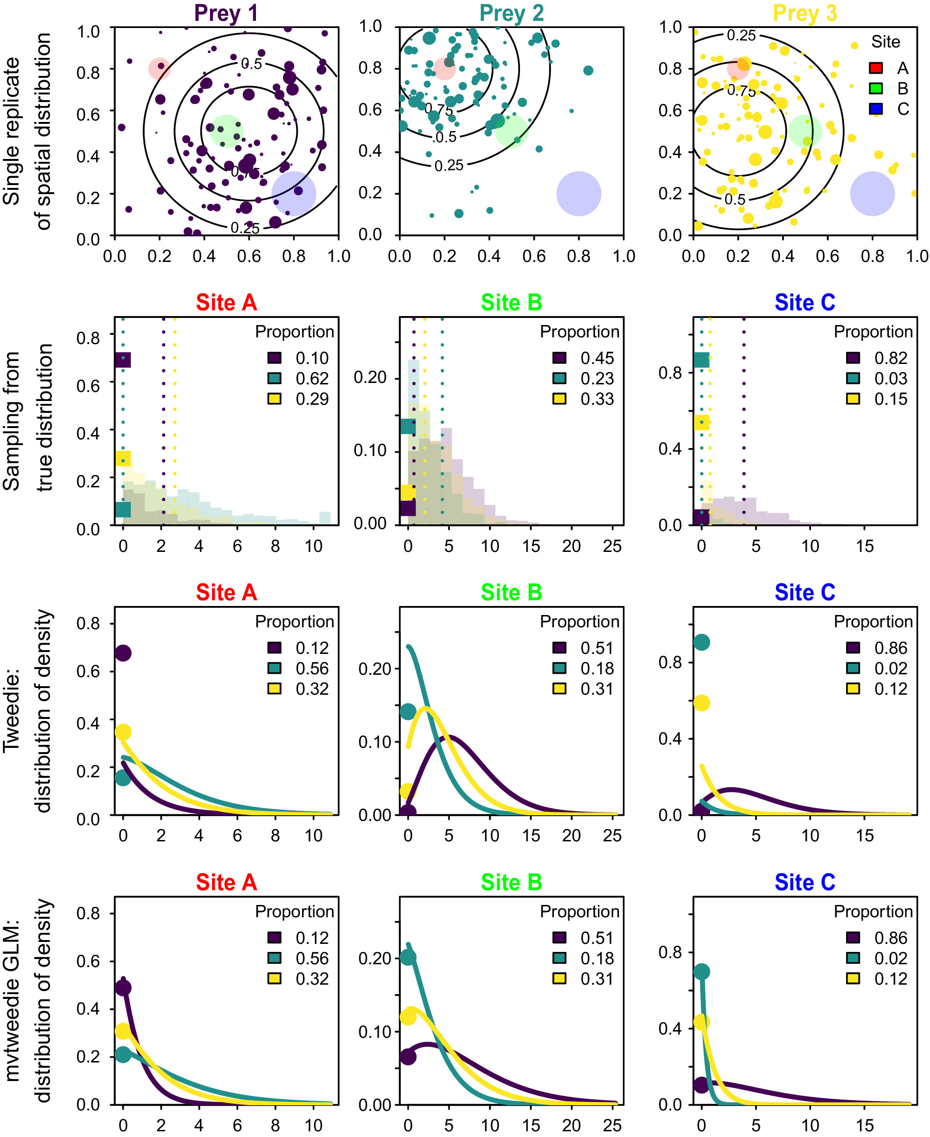
Diet analysis
Treat stomach contents as thinned and marked Point process
Marks
Weight (continuous)
Prey taxa (discrete)
Approximate as GLMM
Tweedie with multiple categories
Thorson, J. T., M. L. Arimitsu, T. Levi, and G. H. Roffler. 2022. Diet analysis using generalized linear models derived from foraging processes using R package mvtweedie. Ecology 103:e3637.

Slide 6
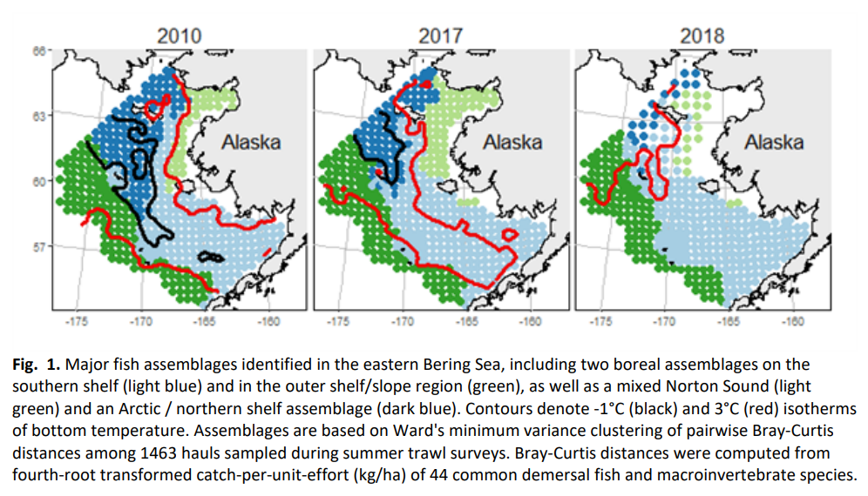
Ordination
Thorson, J. T., M. Fossheim, F. J. Mueter, E. Olsen, R. R. Lauth, R. Primicerio, B. Husson, J. Marsh, A. V. Dolgov, and S. G. Zador. 2019. Comparison of near-bottom fish densities show rapid community and population shifts in Bering and Barents Seas. NOAA.

Slide 7
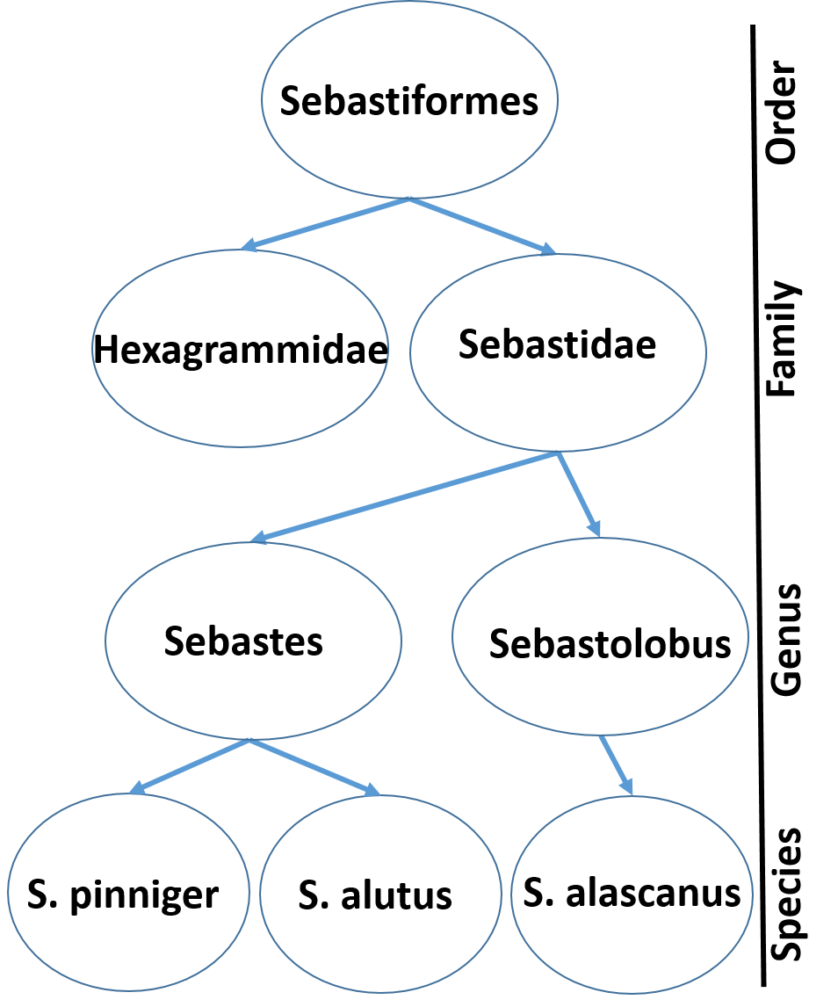
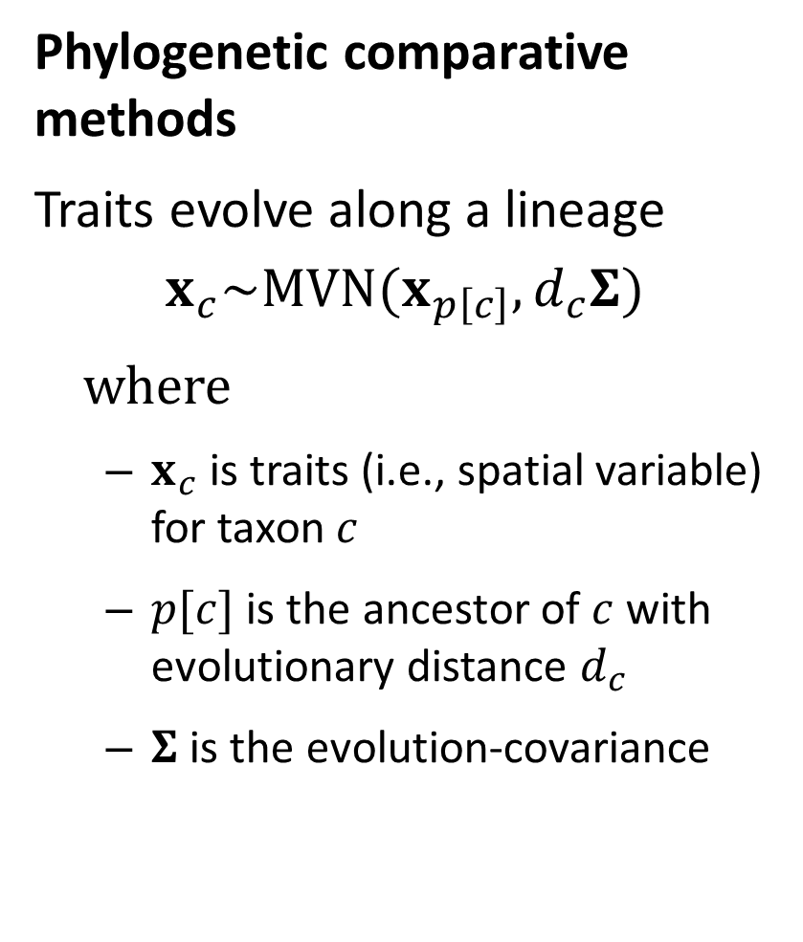
Phylogenetic comparative methods
Traits evolve along a lineage
$$x_{c}\sim MVN(x_{p\left[c\right]},d_{c}Σ)$$
where
$x_{c}$ is traits (i.e., spatial variable) for taxon $c$
$p[c]$ is the ancestor of $c$ with evolutionary distance $d_{c}$
$Σ$ is the evolution-covariance
Thorson, J. T., S. B. Munch, J. M. Cope, and J. Gao. 2017. Predicting life history parameters for all fishes worldwide. Ecological Applications 27:2262–2276.

Slide 8
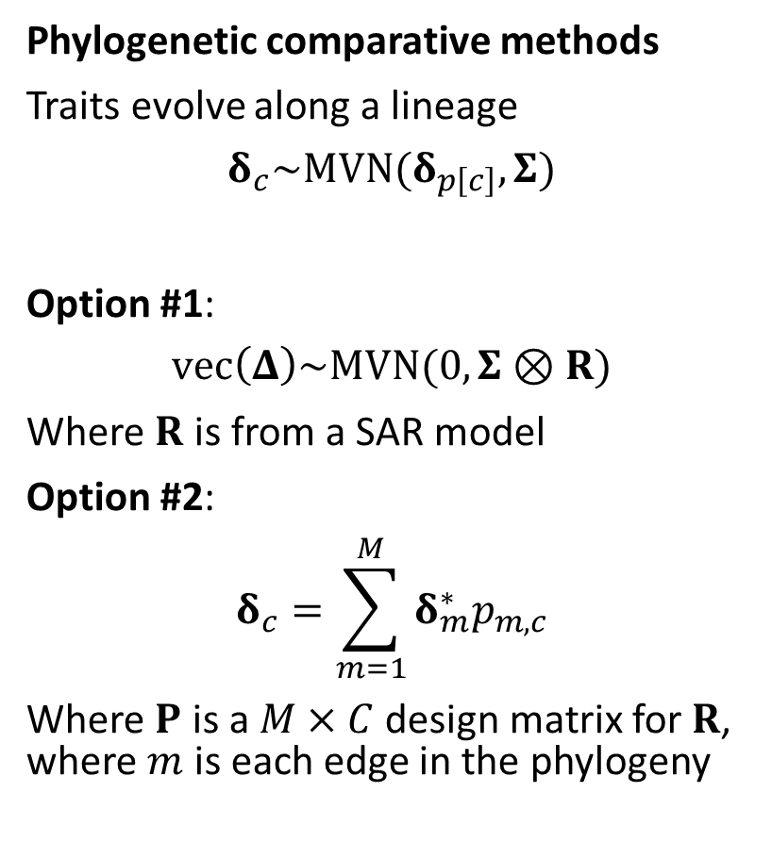
Phylogenetic comparative methods
Traits evolve along a lineage
$$δ_{c}\sim MVN(δ_{p\left[c\right]}, Σ)$$
Option #1:
$$vec\left(Δ\right)\sim MVN(0,Σ⊗R)$$
Where $R$ is from a SAR model
Option #2:
$$δ_{c}=\sum_{m=1}^{M}{δ_{m}^{∗}p_{m,c}}$$
Where $P$ is a $M×C$ design matrix for $R$, where $m$ is each edge in the phylogeny
Thorson, J. T., S. B. Munch, J. M. Cope, and J. Gao. 2017. Predicting life history parameters for all fishes worldwide. Ecological Applications 27:2262–2276.

Slide 9
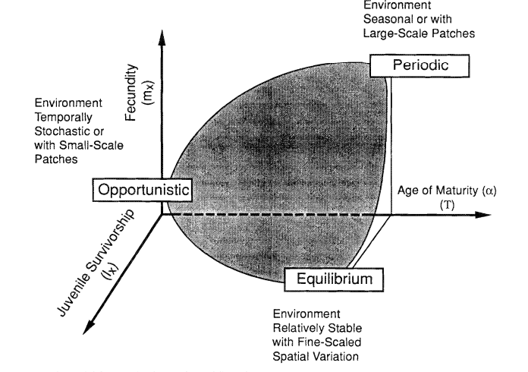
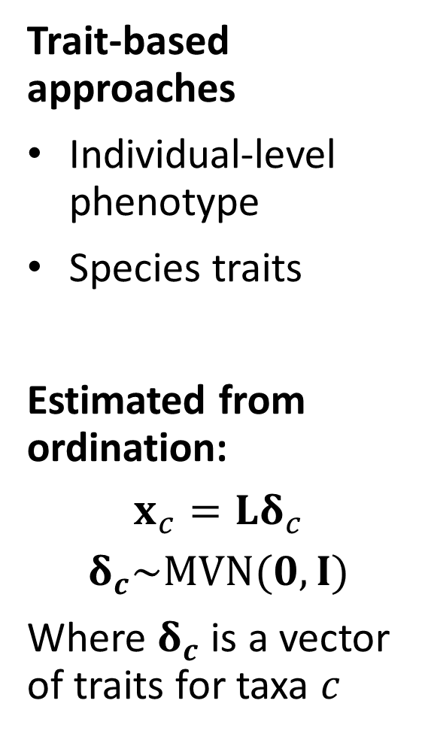
Trait-based approaches
Individual-level phenotype
Species traits
Estimated from ordination:
$$x_{c}=Lδ_{c}$$
$$δ_{c}\sim MVN(0,I)$$
Where $δ_{c}$ is a vector of traits for taxa $c$
Winemiller, K. O., and K. A. Rose. 1992. Patterns of life-history diversification in North American fishes: implications for population regulation. Can. J. Fish. Aquat. Sci. 49:2196–2218.

Slide 10
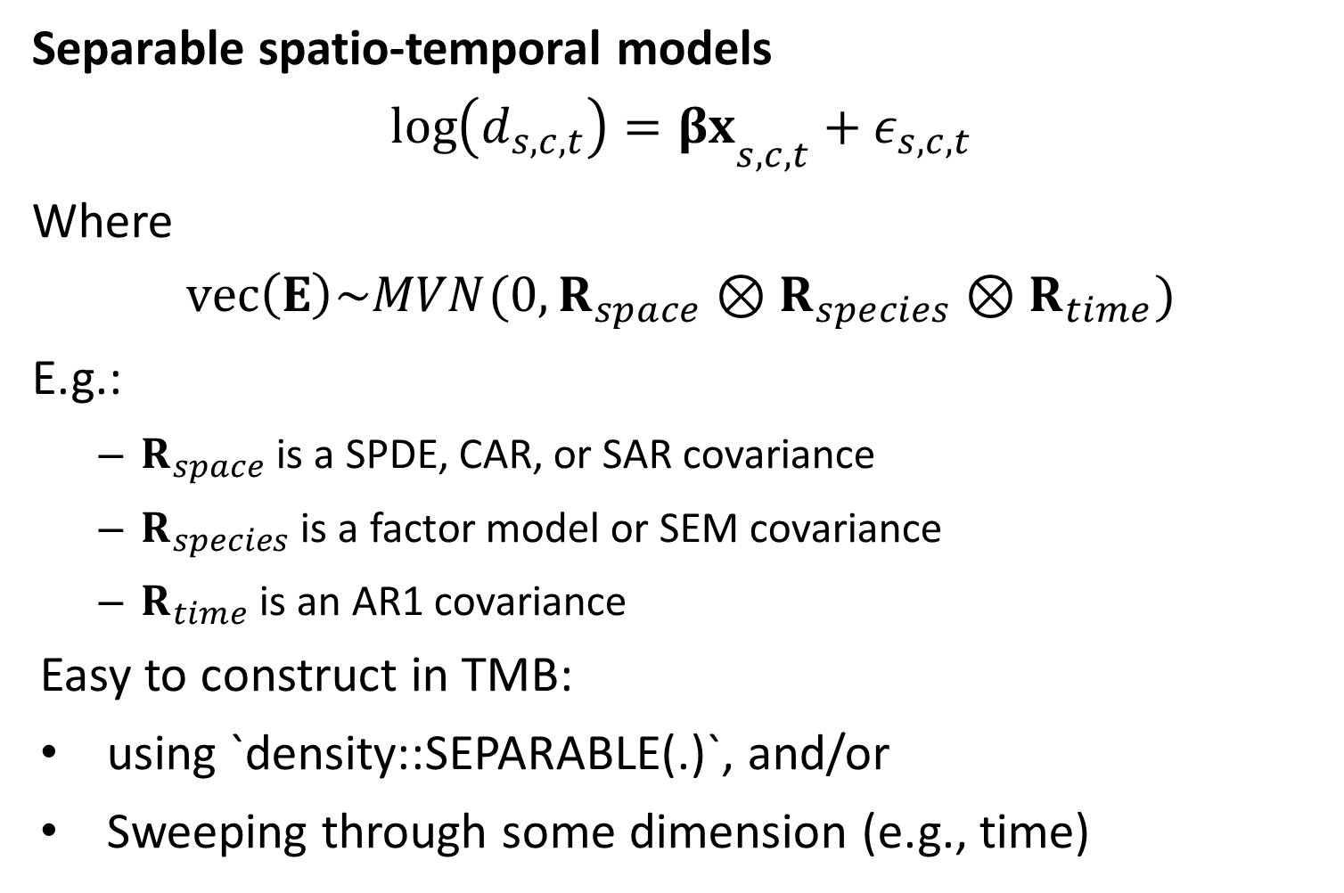
Separable spatio-temporal models
$${\log\left(d_{s,c,t}\right)=βx}_{s,c,t}+ε_{s,c,t}$$
Where
$$vec\left(E\right)\sim MVN(0,R_{space}⊗R_{species}⊗R_{time})$$
E.g.:
$R_{space}$ is a SPDE, CAR, or SAR covariance
$R_{species}$ is a factor model or SEM covariance
$R_{time}$ is an AR1 covariance
Easy to construct in TMB:
using `density::SEPARABLE(.)`, and/or
Sweeping through some dimension (e.g., time)

Slide 11
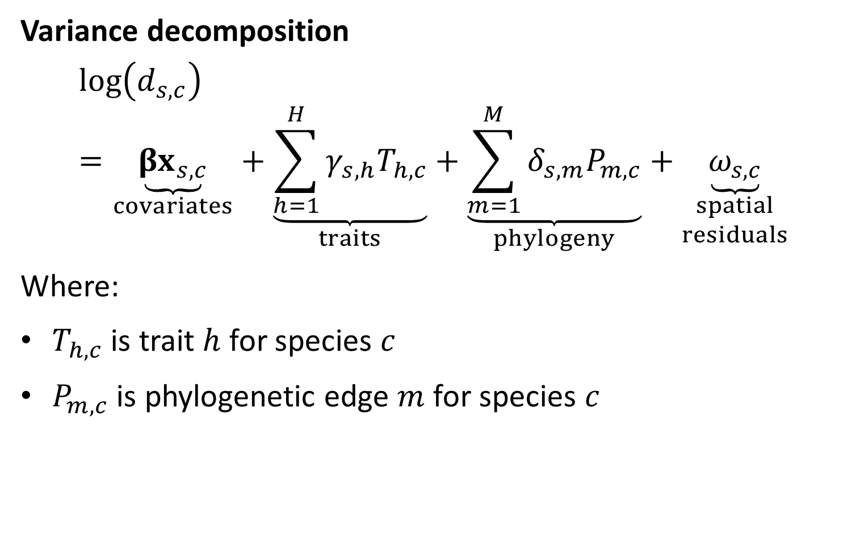
Variance decomposition
$$\log\left(d_{s,c}\right)=\underset{covariates}{\underbrace{{βx}_{s,c}}}+\underset{traits}{\underbrace{\sum_{h=1}^{H}{γ_{s,h}T_{h,c}}}}+\underset{phylogeny}{\underbrace{\sum_{m=1}^{M}{δ_{s,m}P_{m,c}}}}+\underset{\begin{aligned}spatial \\ residuals\end{aligned}}{\underbrace{ω_{s,c}}}$$
Where:
$T_{h,c}$ is trait $h$ for species $c$
$P_{m,c}$ is phylogenetic edge $m$ for species $c$

